Slide 1

Generative AI-Powered Customer Service Chatbot
Joshua Bradley
The Pennsylvania State University
Software System Design 837
Professor Nalubandhu

Slide 2

Problem Statement:
Create a chatbot powered by ChatGPT 4.0 and incorporate it in our website to help customers.

Slide 3

THE POWER OF artificial intelligence

Slide 4

Discovering stakeholder’s needs
CONFIDENCE-BUILDING Use Cases

Slide 5

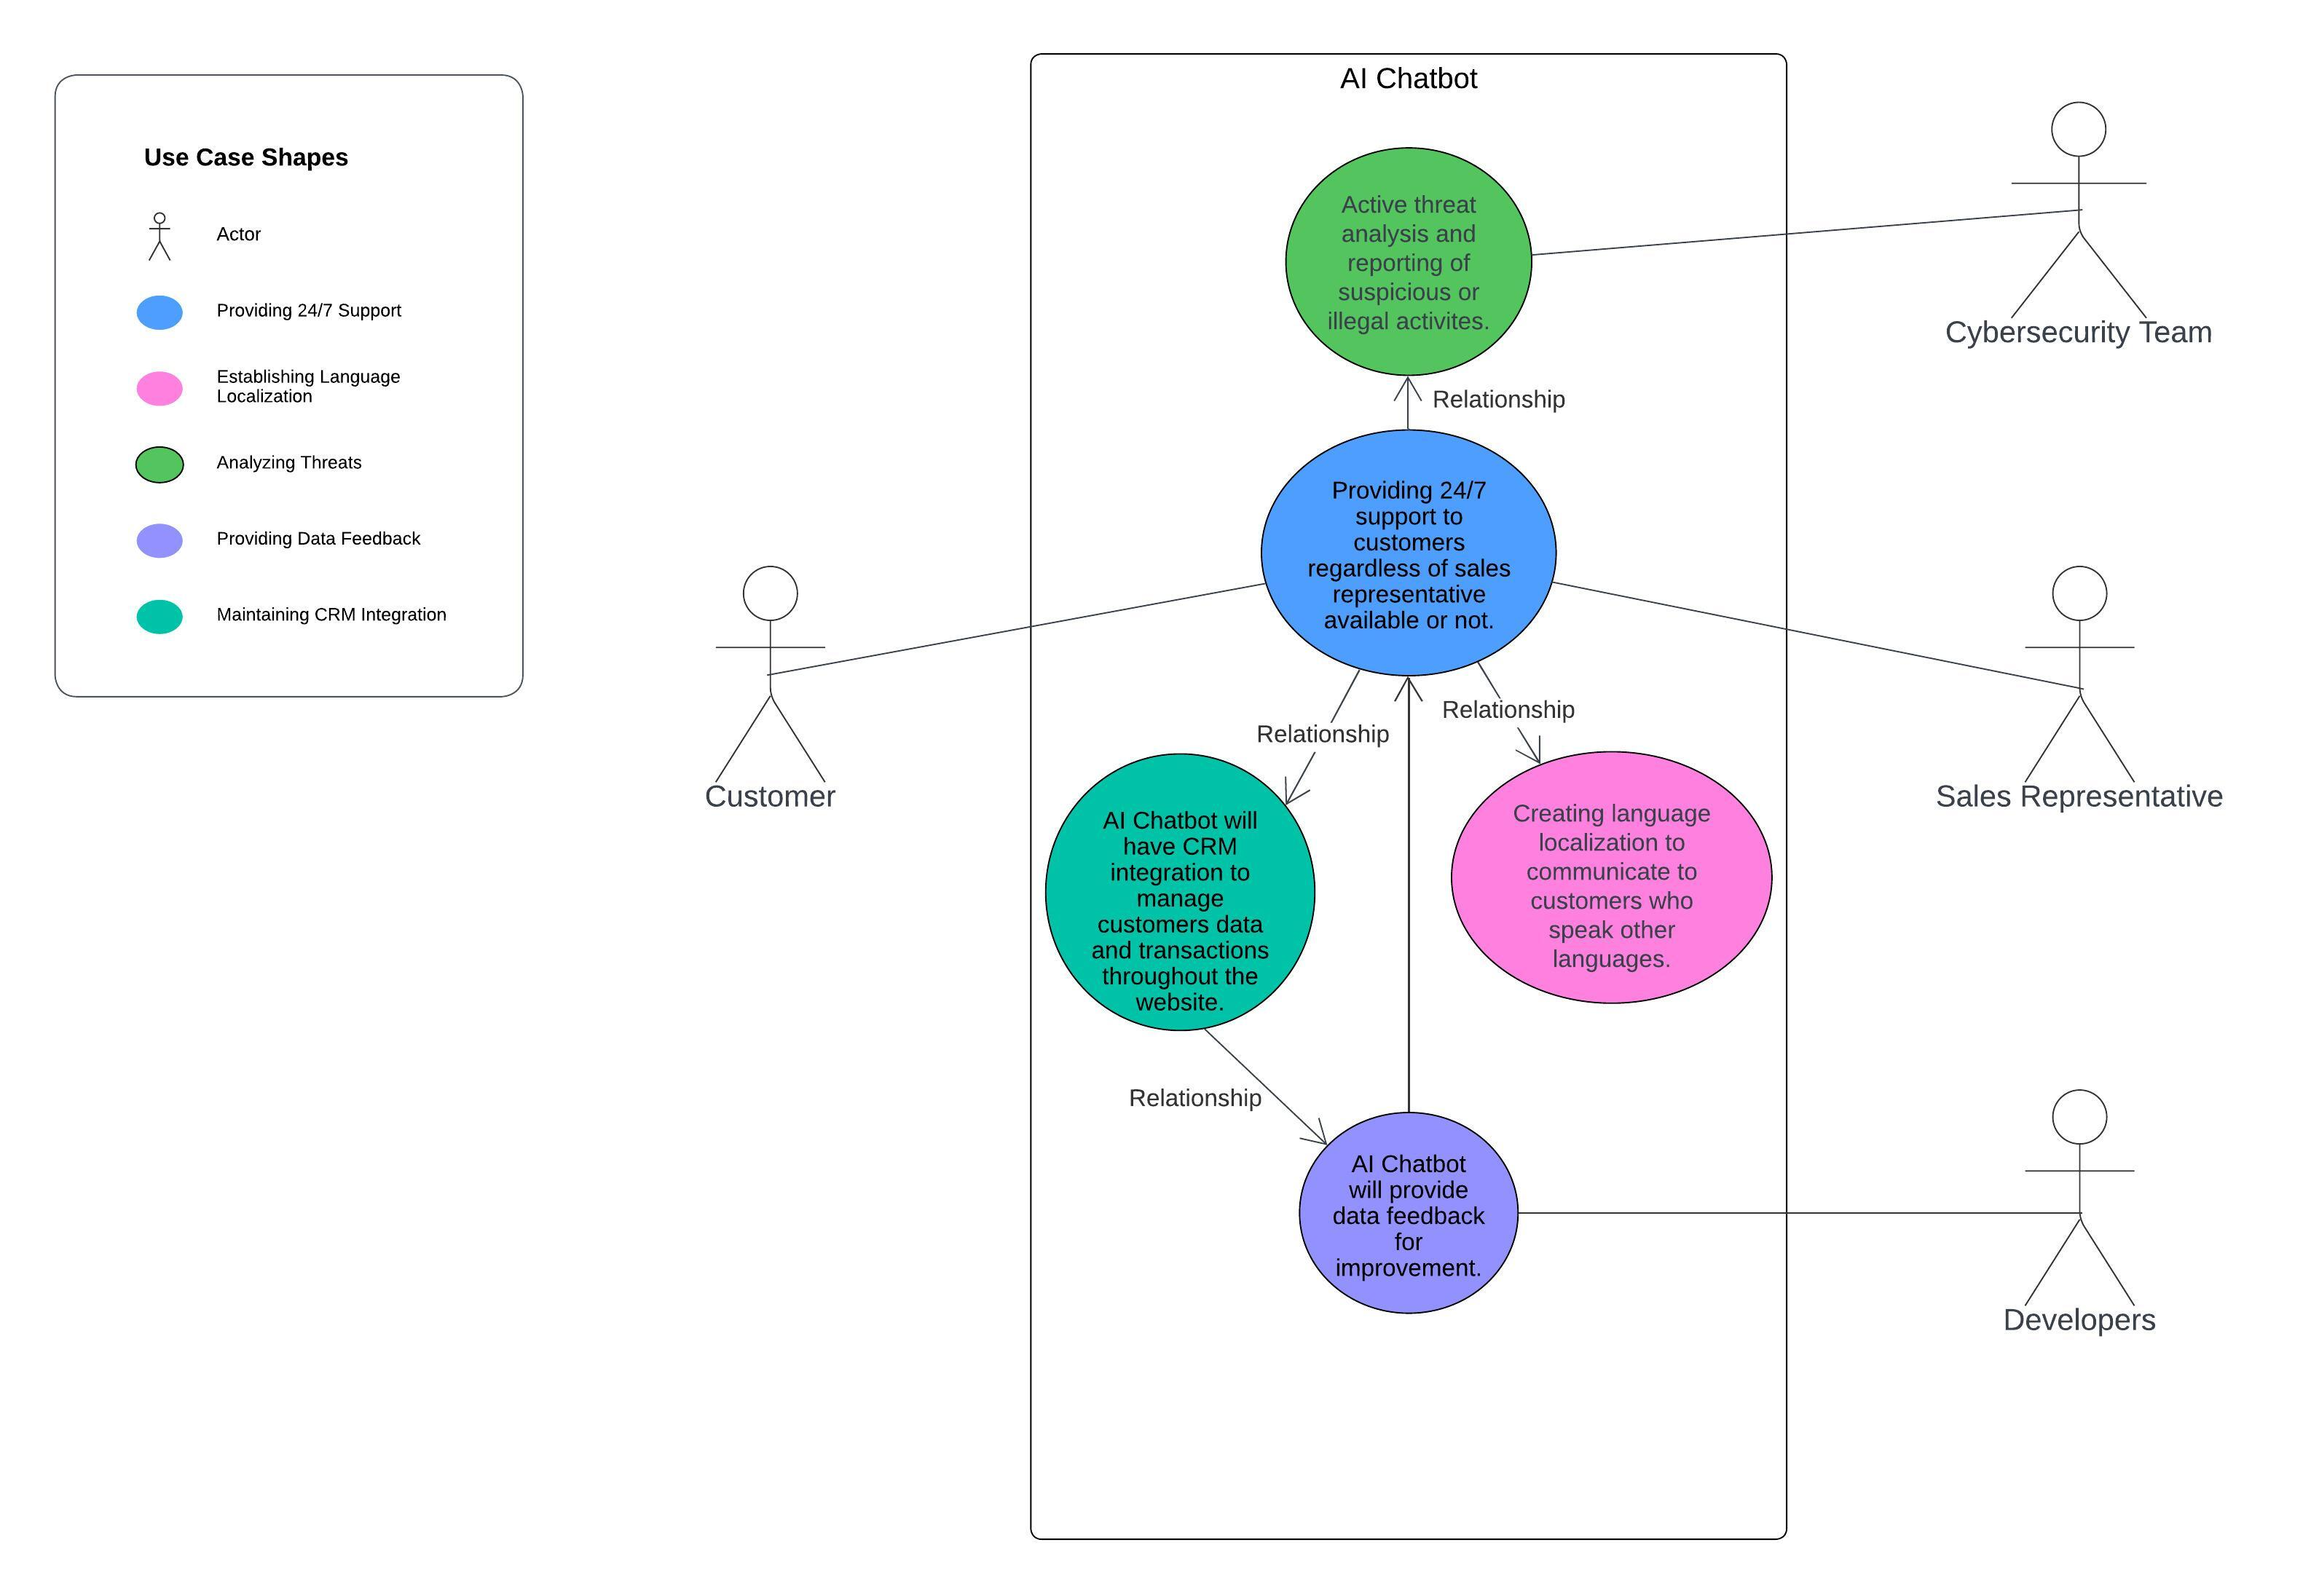
Ai chatbot use cases

Slide 6
SELECTING Domain classes
ENHANCING our ai

Slide 7
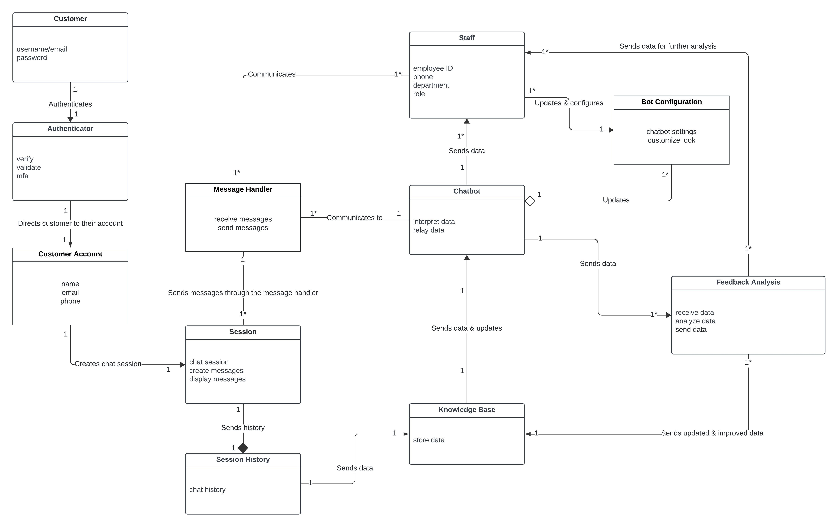
domain model

Slide 8
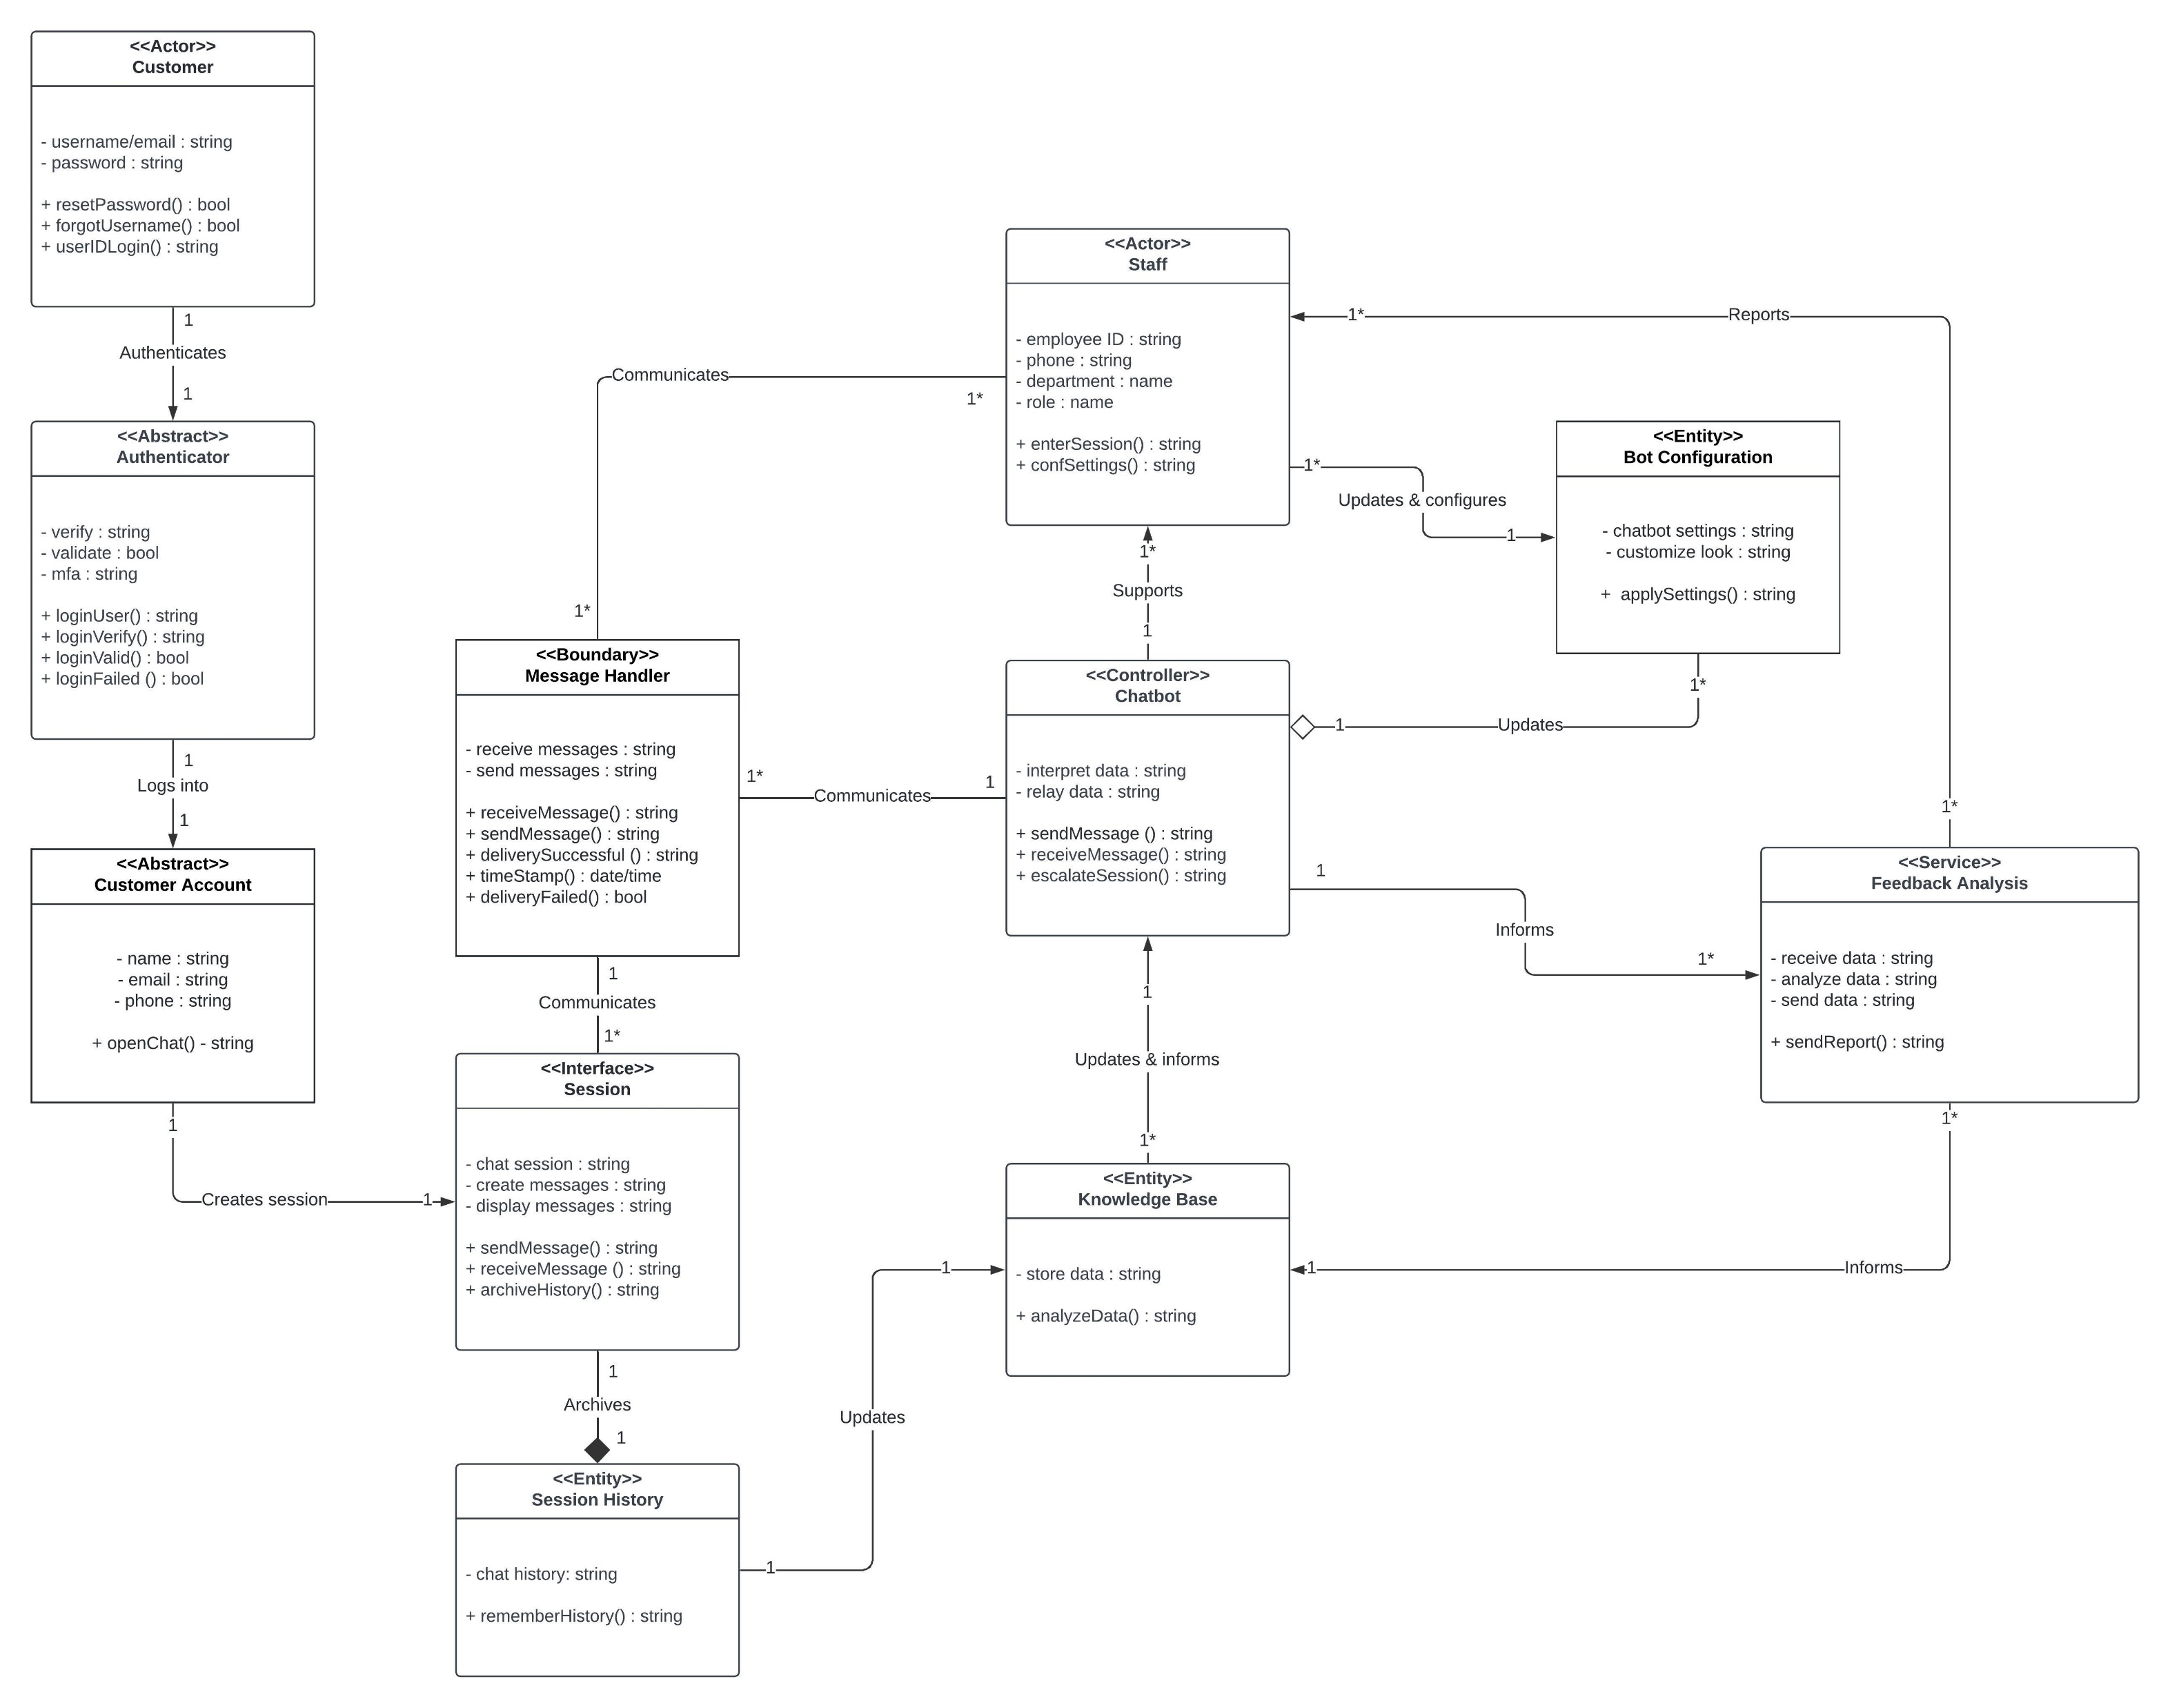
Domain Class Diagram

Slide 9

Grasp Patterns used in the ai chatbot design
For the AI Chatbot itself, this is a controller class and expert class knowing what classes need to handle what responsibilities. This mediates tasks from the other classes and controls the flow of the system. I set up other classes such as feedback analysis, bot configuration, and message handler to prevent it from becoming a god class.
The Message Handler class is an indirection class or mediator class and promotes low coupling within the system. It prevents the session class from getting entangled with the chatbot and staff classes by handling the messages and documents sent to these classes and vice versa.
The Customer Account class is a creator class. It creates a new session class to begin the conversation with the chatbot.

Slide 10
Other Design Patterns & architecture used in the ai chatbot design
KISS Design Principle was considered for this design. We want a simplistic design that is easy to understand and modify for future use.
YAGNI Design Principle was implemented in this design. We do not need to overcomplicate the design by adding additional features that may or may not be used. We only need the chatbot to conversate/translate with the customers/staff, escalate to staff, report feedback, and be reconfigured based on that feedback.
The Monolith Architecture was used to design the AI chatbot. The Monolithic design is best since we are looking for a simpler design. Monolith architecture has a good balance of fast deployment, simplicity and easier to manage and maintain.

Slide 11
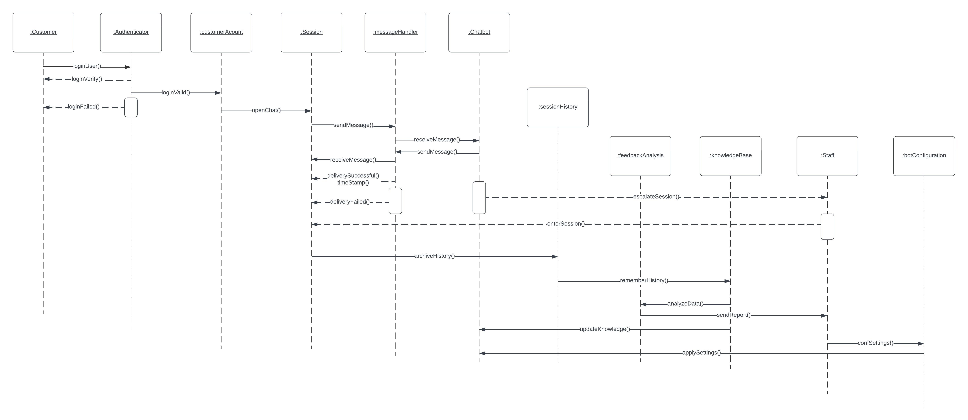
Interaction Sequence Diagram

Slide 12
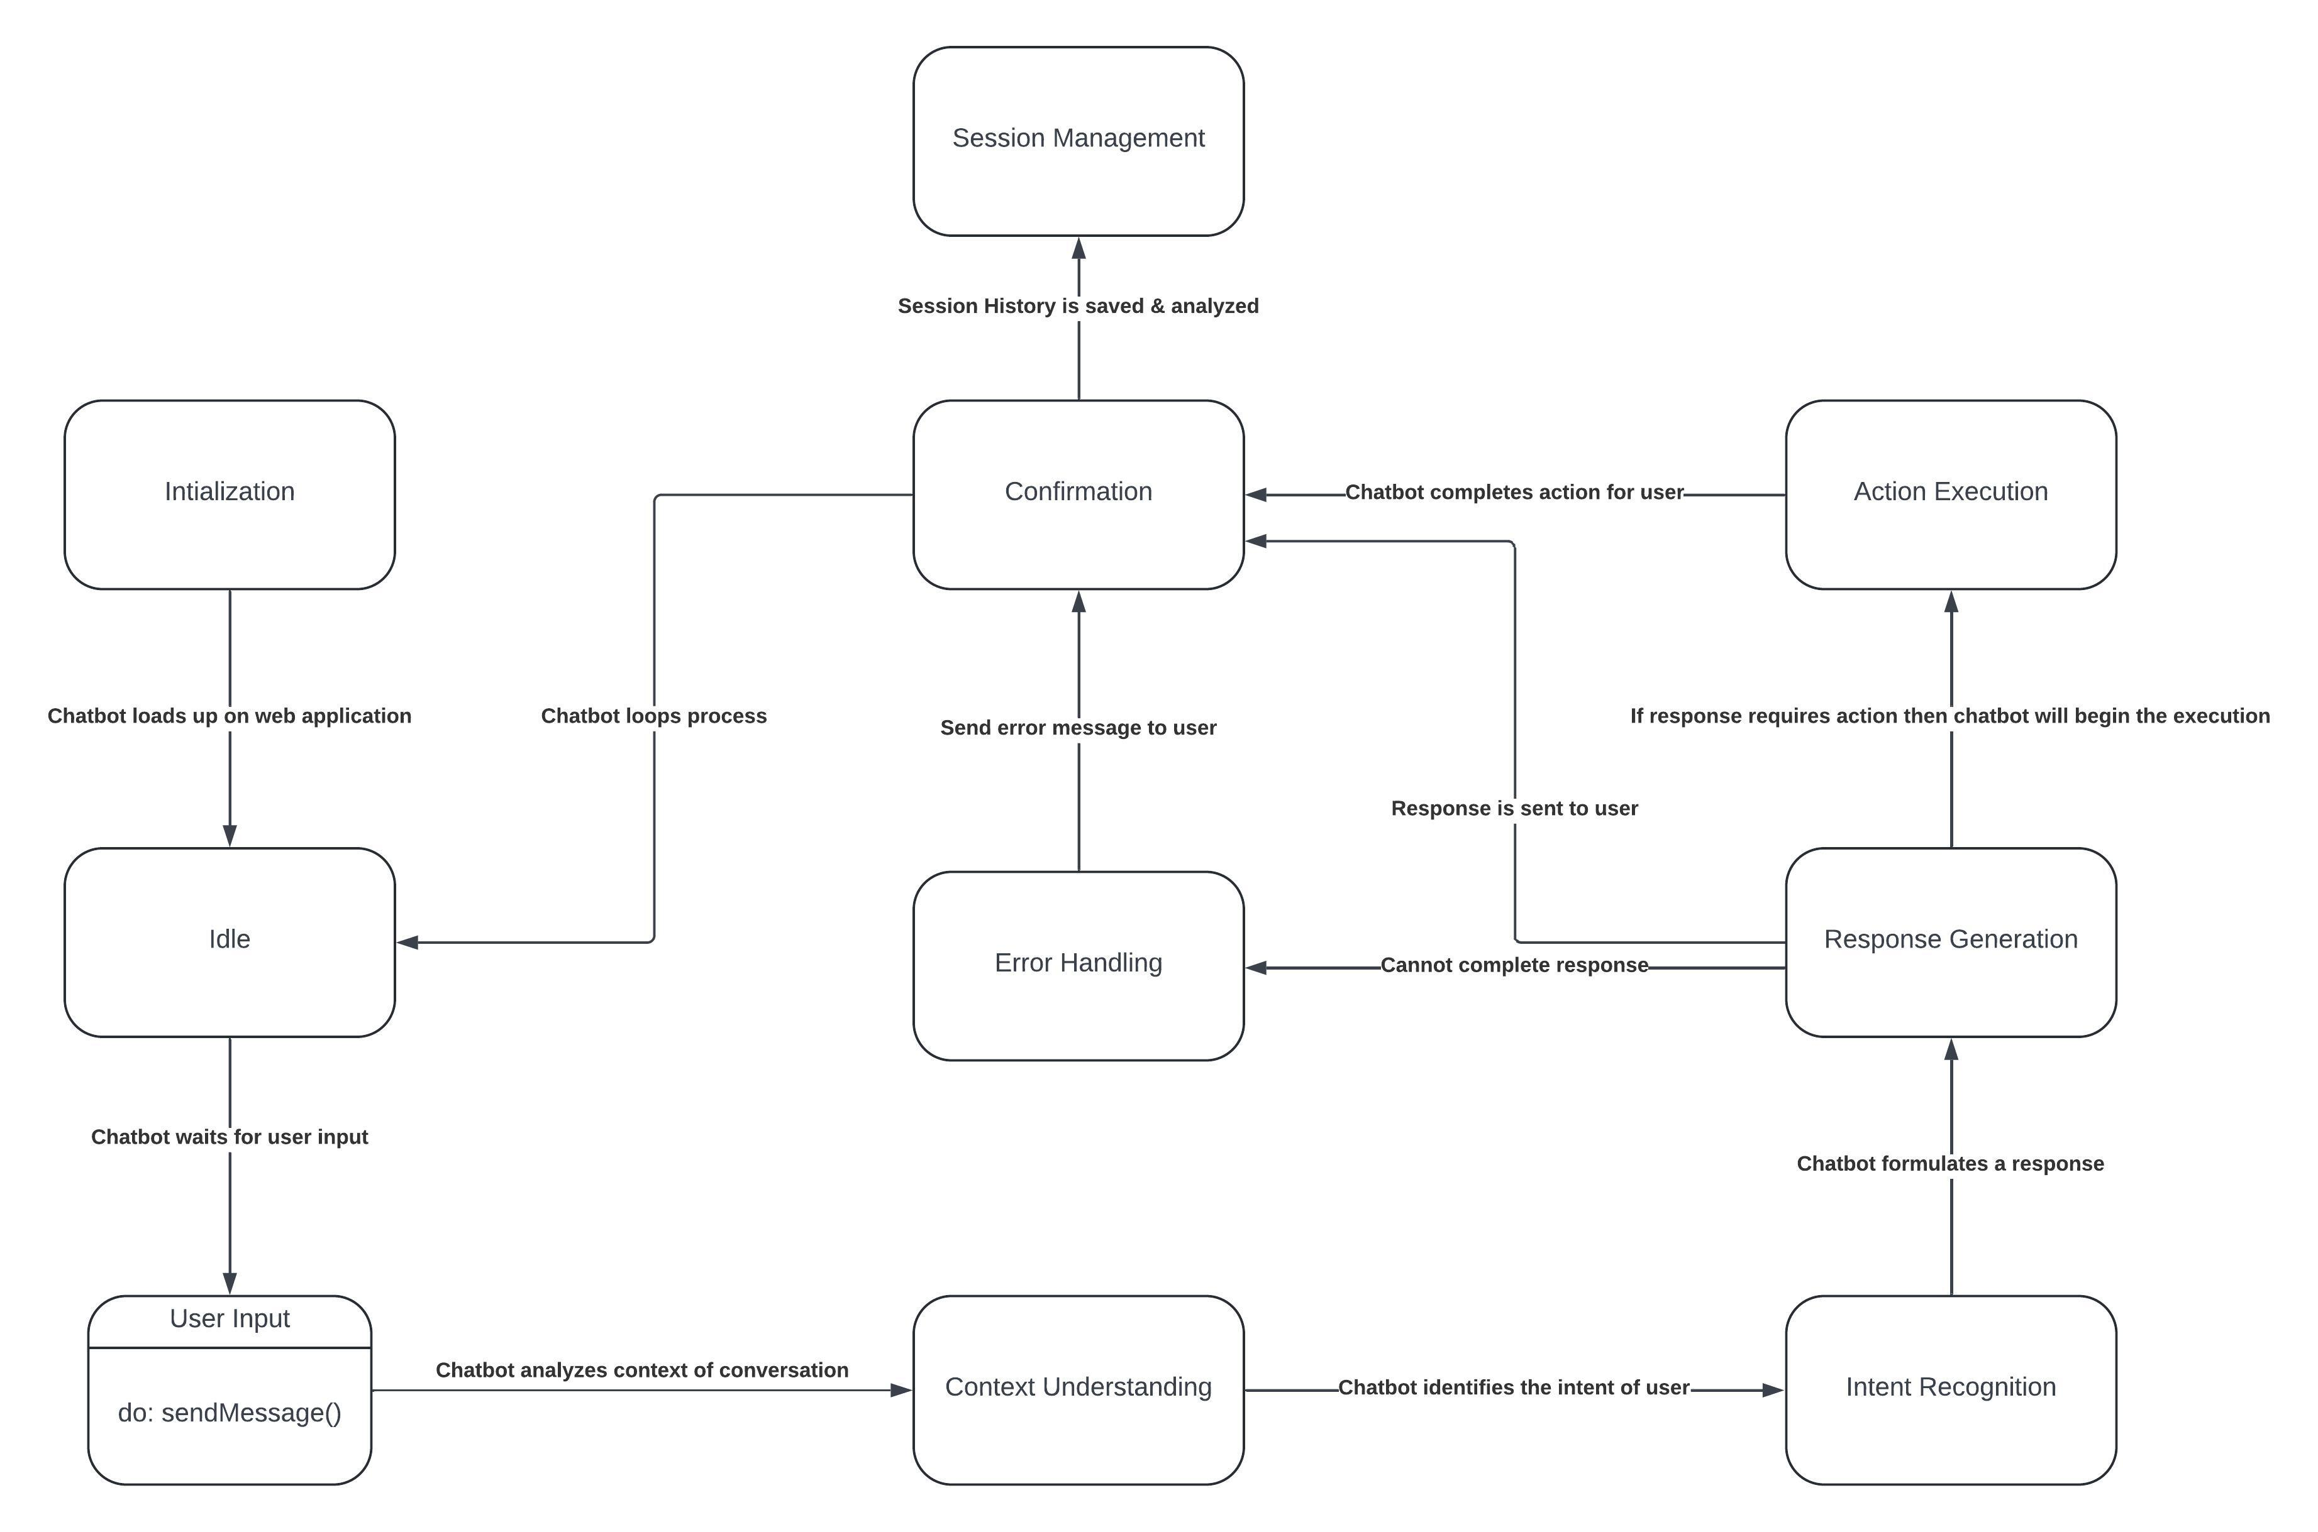
State diagram

Slide 13
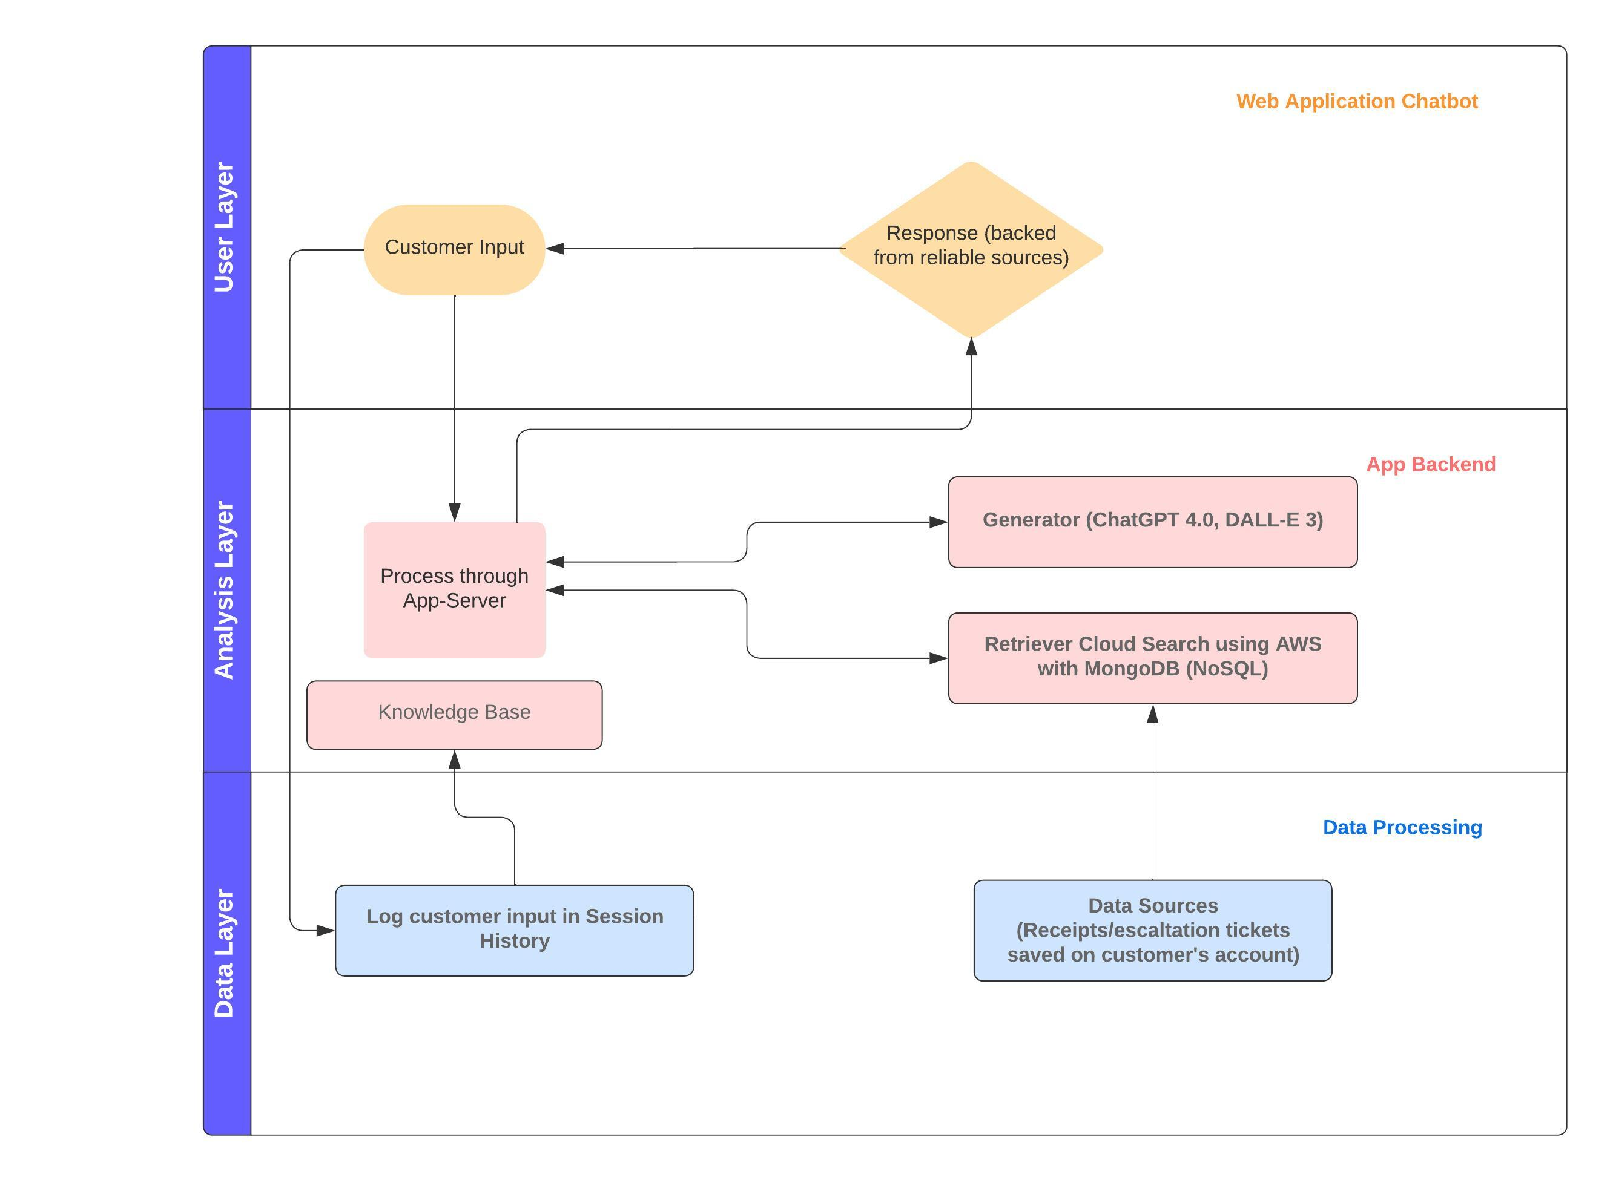
Swimlanes diagram

Slide 14
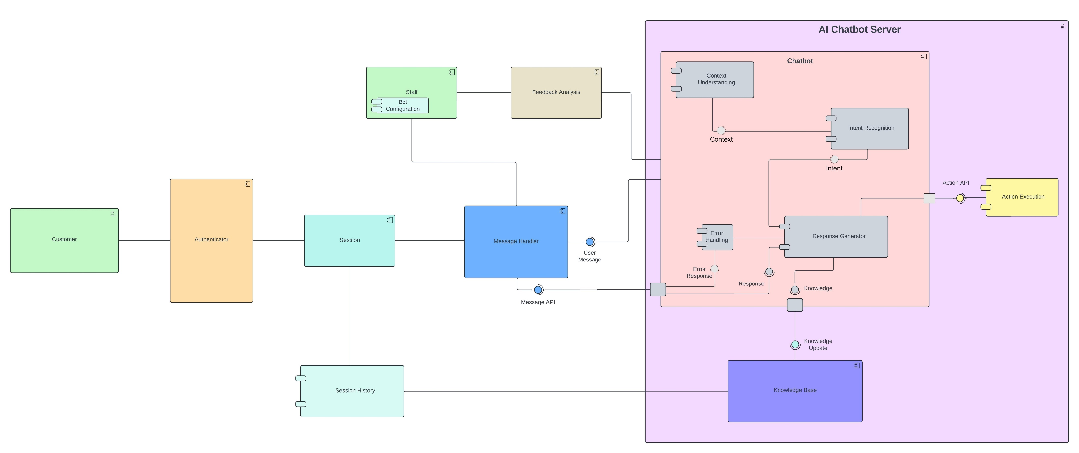
Component diagram

Slide 15
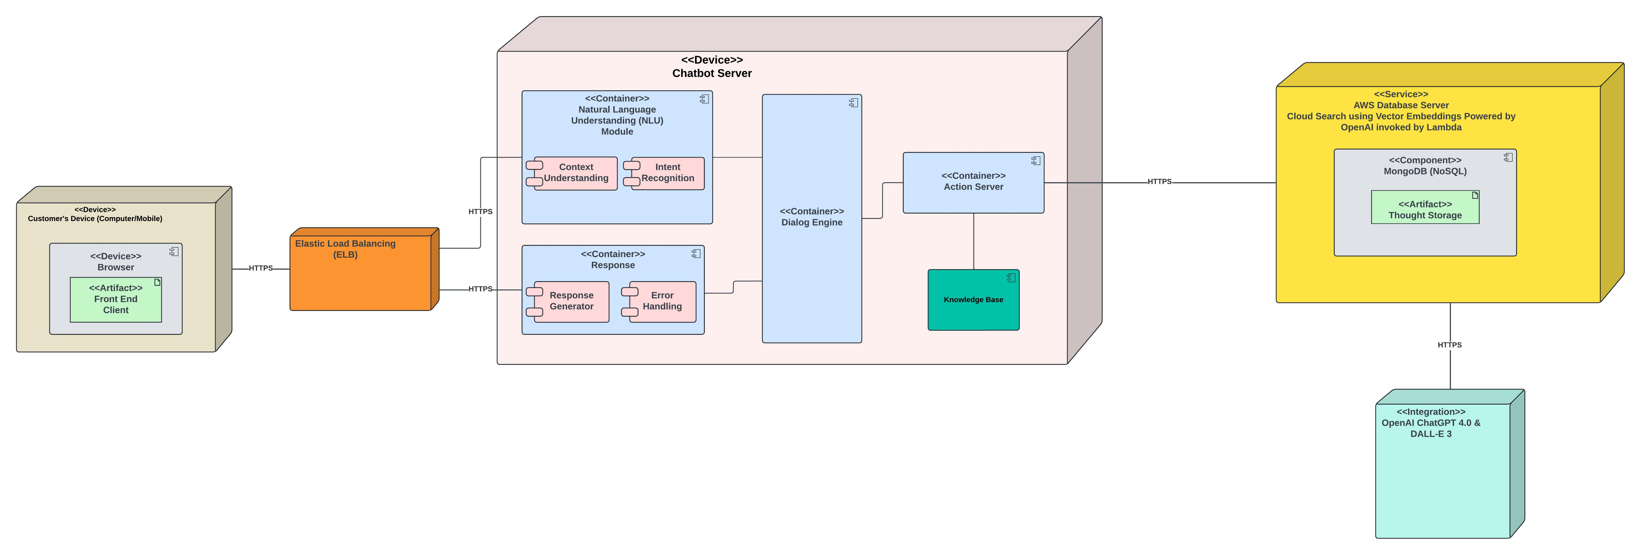
Cloud deployment diagram

Slide 16

THANK YOU

